Slide 1
Development approaches
Notes:
Discuss what things were developed

Slide 2
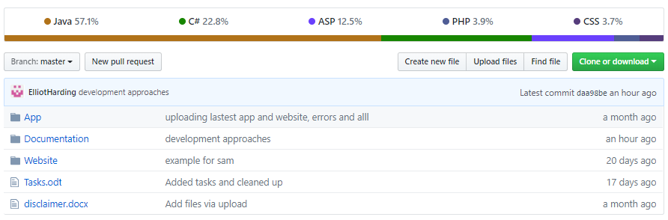
Github

Slide 3
Hosting
Gear Host
Allows asp.net files to be hosted
Has a MySQL database hosting
Easy to set up
Free

Slide 4
Database Development
Languages
Database language → MYSQL
Communication with app → PHP
Communication with website → MySql.Data.dll library
Management
The database was created, and continues to be managed using MySQL workbench 6.3
Visualisation on next page

Slide 5
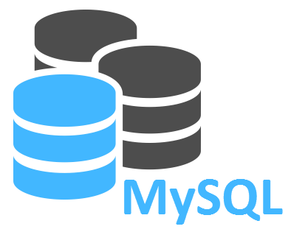
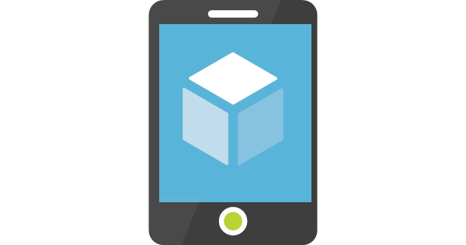

Communication Structure
Server
APP
Local SQLite database
Website

Slide 6
Website Development
Languages
Code → C#
GUI → HTML with ASP.net framework
Adding to the host
The FTP application File Zilla was used to upload the websites code to the Gear Host server

Slide 7
App Development
Languages
Code → Java
GUI → XAML
Host
The app was uploaded to the google play store, and is configured to be compatible with most android versions.
Database communication
The SQLite java library is used within the app to manipulate the databases information. PHP, hosted on the gear host server is used to communicate between app users and the MySQL database.

Slide 8
Links
https://manjaro.site/grant-remote-access-mysql-server-debian-9-stretch/ (Server Picture)
https://azure.microsoft.com/en-gb/services/app-service/mobile/ (App picture)
https://www.researchnow.com/about-us/ (Website Picture)

